Slide 1
LECTURE 6 TURING MACHINES
CSc 304
Stephen Lucci

Slide 2
Keywords
Unary number theoretic functions
Function computation paradigm
Symbol manipulation
Language recognition paradigm
Transduction paradigm
“in-principle” computability
Computational feasibility

Slide 3
Turing Machines: Formal Definition
We Assume some finite input alphabet
∑ = { a₁, … , a_{k}}
Every Turing machine has a finite nonempty set of states Q = { q₀, q₁, … , q_{n}}
A distinguished initial state: q_{init}
We shall assume this is q₀

Slide 4
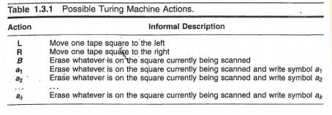
With ∑ = { a₁, … , a_{k}}
Identify k+3 r/w head actions

Slide 5
Turing Machines Formally
A Turing machine (Tm) instruction:
< q_{i}, 𝞼, action , q_{j} > : A quadruple
q_{i} : current state
𝞼 : element of ∑ U B
Action: k+3
q_{j} : next state (NOTE: q_{i} can equal q_{j})
Possible Machine Actions:
Write any of a₁…a_{k}
Move left one square L
Move right one square R
Erase symbol being scanned B
Or may write auxiliary symbols: *, x, y, etc. (𝞒 : auxiliary alphabet)

Slide 6
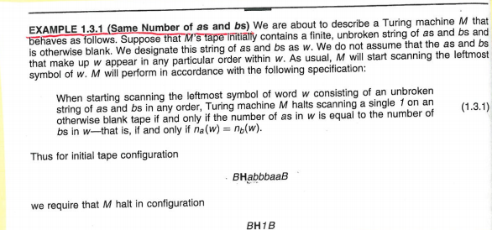
Example
We begin with a strategy…

Slide 7
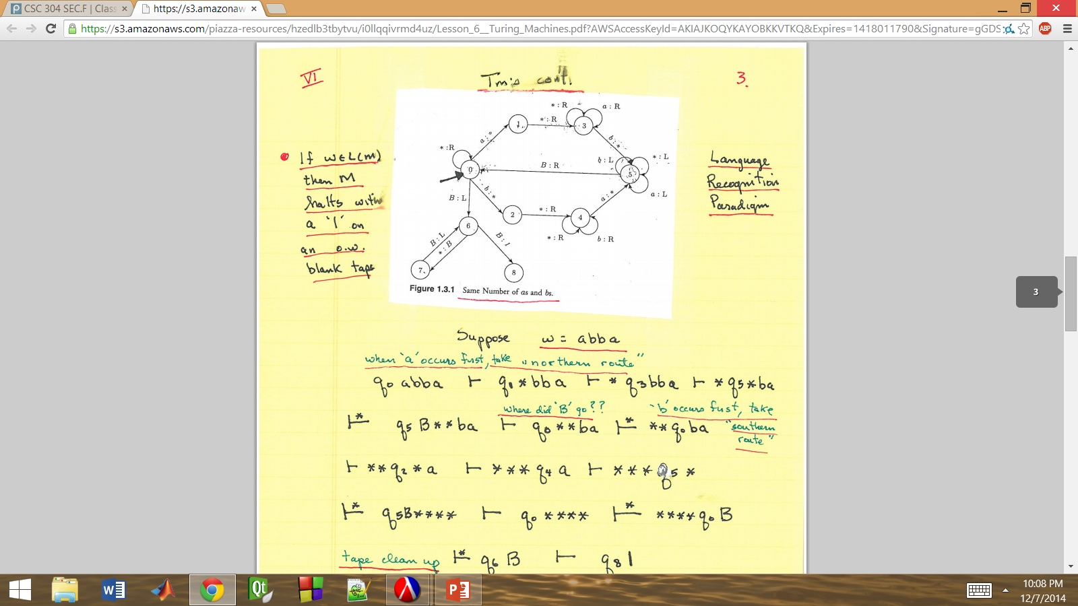
Turing Machines Continued
If ω ε L (m)
then M halts with a ‘1’ on an otherwise blank tape
Language
Recognition
Paradigm

Slide 8
Suppose ω = abba (when a occurs first, take “northern route”)
| q₀ abba | q₀ *bba | q₃ *bba | q₅ **ba | q₅ **ba | q₅ B**ba | q₀ **ba
(Where did B go?)
(‘b’ occurs first, take “southern route”)
| q₂ ***a | q₄ ***a | q₅ **** | q₀ **** | q₆ ****
Tape cleanup: | q₆ B | q₈ 1

Slide 9
And what if ω = a
b
aba
bba
bab ??

Slide 10
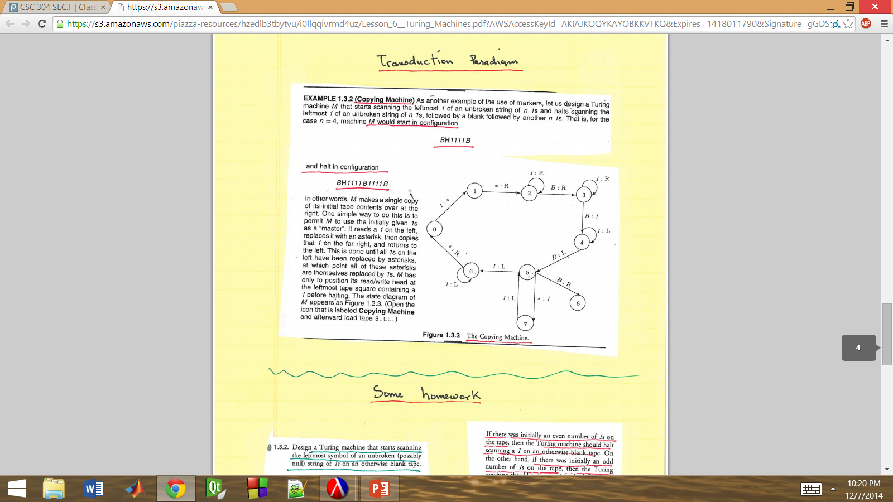
Transduction Paradigm

Slide 11
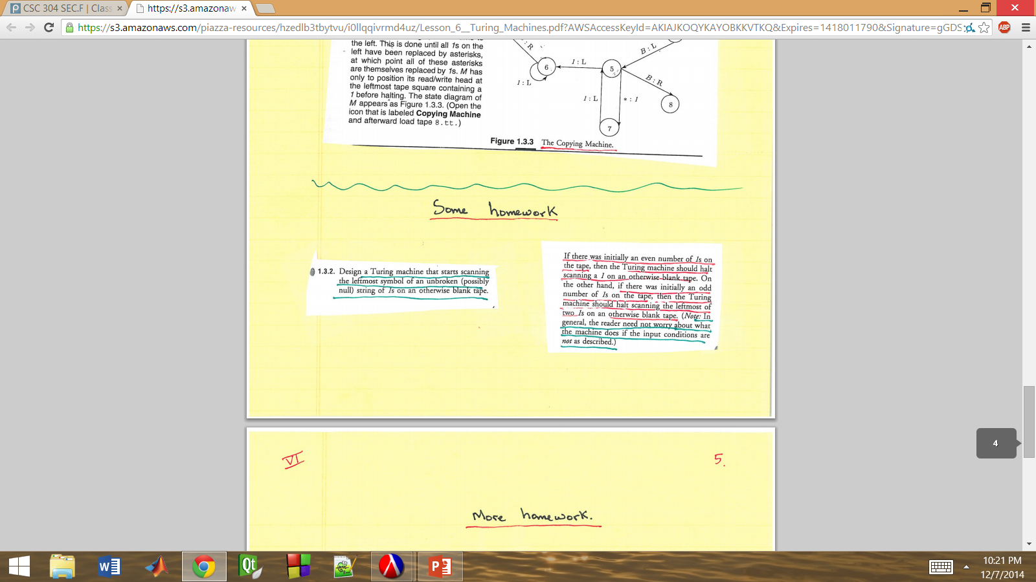
Some Homework

Slide 12
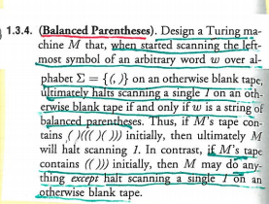
More Homework
Language Recognition
A Tm to decide (recognize) the language L of well-balanced parenthesized expressions

Slide 13
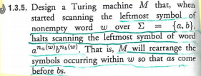
More Homework
A Turing Transducer

Slide 14
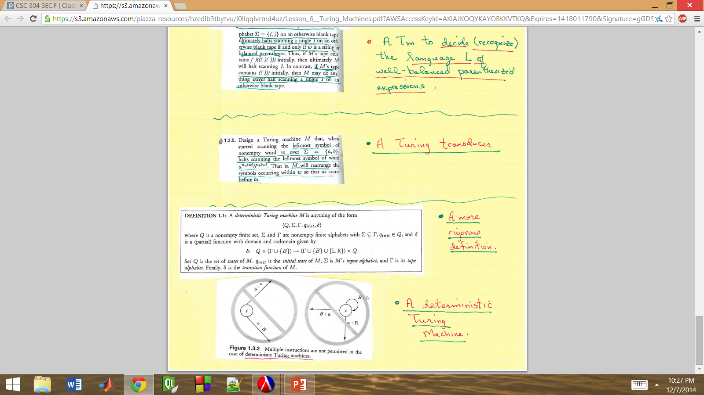
More Homework
A more rigorous definition

Slide 15
A Deterministic Turing Machine

